Slide 1
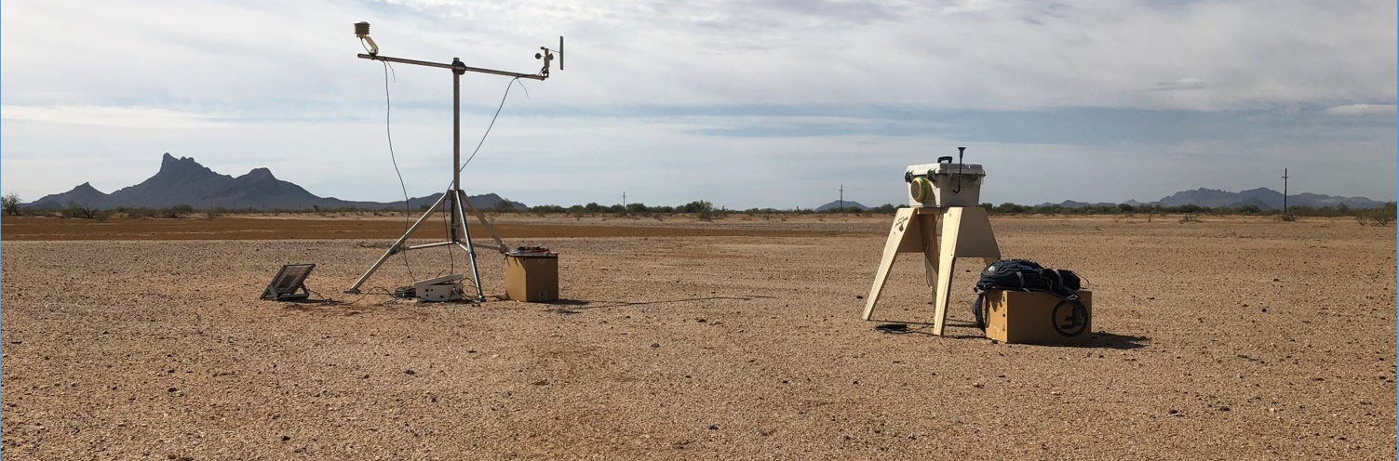




Evaluation of Threshold Friction Velocities at Potential Dust Sources in Semi-Arid Regions
Arizona Space Grant Symposium 2020
HAS Superfund Laboratory
Presenter: Ruby O’Brien-Metzger
Mentors: Dr. Eric Betterton, Dr. Eduardo Saez, Kyle Rine
Funded By: NIEHS Superfund Research Program, NASA Space Grant Program

Slide 2
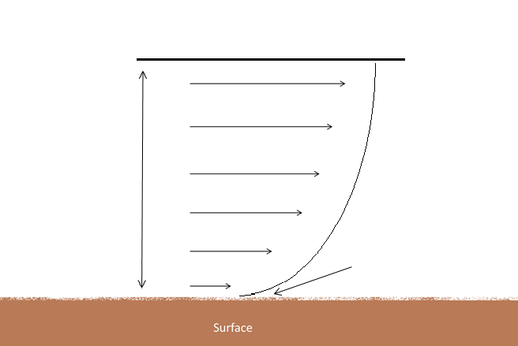
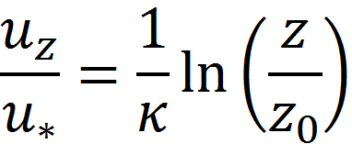


Theory
Friction Velocity
Shear stress at the surface
Mechanical erosion
Threshold Friction Velocity
Friction velocity that is needed for mechanical erosion
u_{f}
Log-Wind Profile
u_{z}: Wind speed at height Z
κ: Von Kármán constant (0.4)
z_{o}: Roughness length
u*: Friction velocity
u_{z}
z
u*
z_{o}

Slide 3
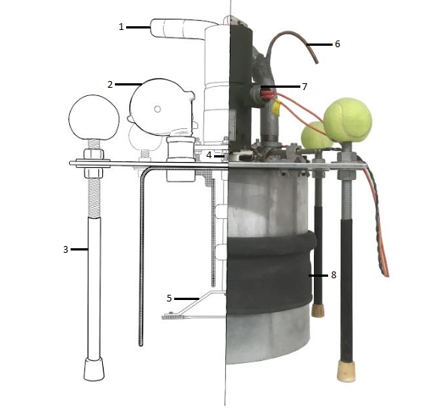
Portable Dust Generator
Based on PI-SWERL by DRI
Produces a known wind speed
Measures real time dust production
Lightweight and Compact
1. Exhaust Tube 2.Blower 3.Adjustable legs 4.Hall Sensor 5.Annular Ring 6.Isokinetic Sampling Port 7.Motor 8.Adjustable Skirt

Slide 5
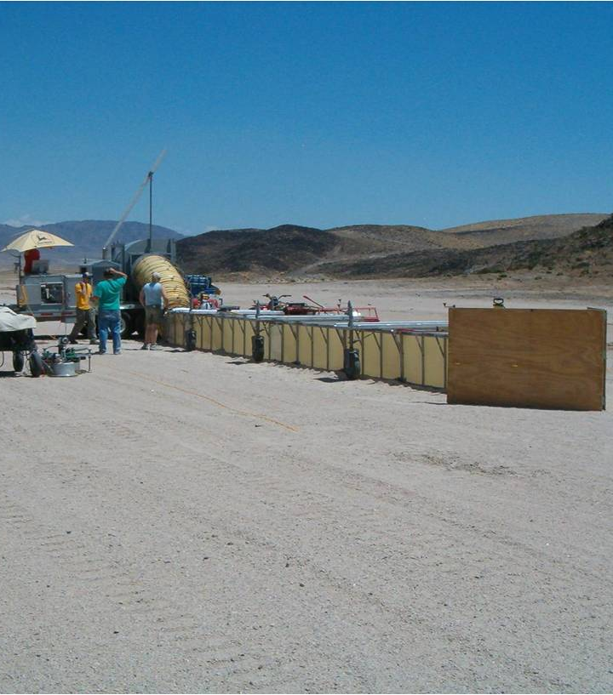
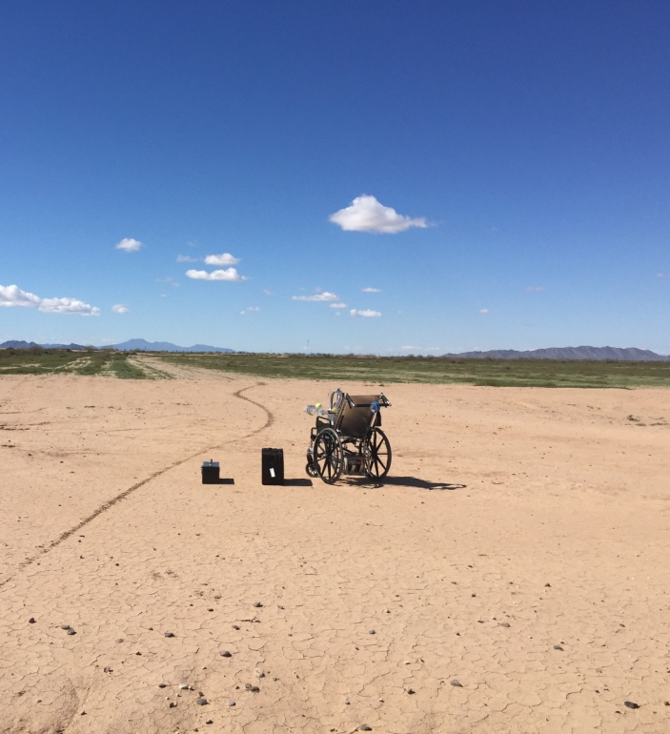
Lower Cost
Lower maintenance
Less labor required
Smaller foot print
Ease of use
Traditional Wind Tunnel
Portable Dust Generator
Photo Credit: Desert Research Institute

Slide 6

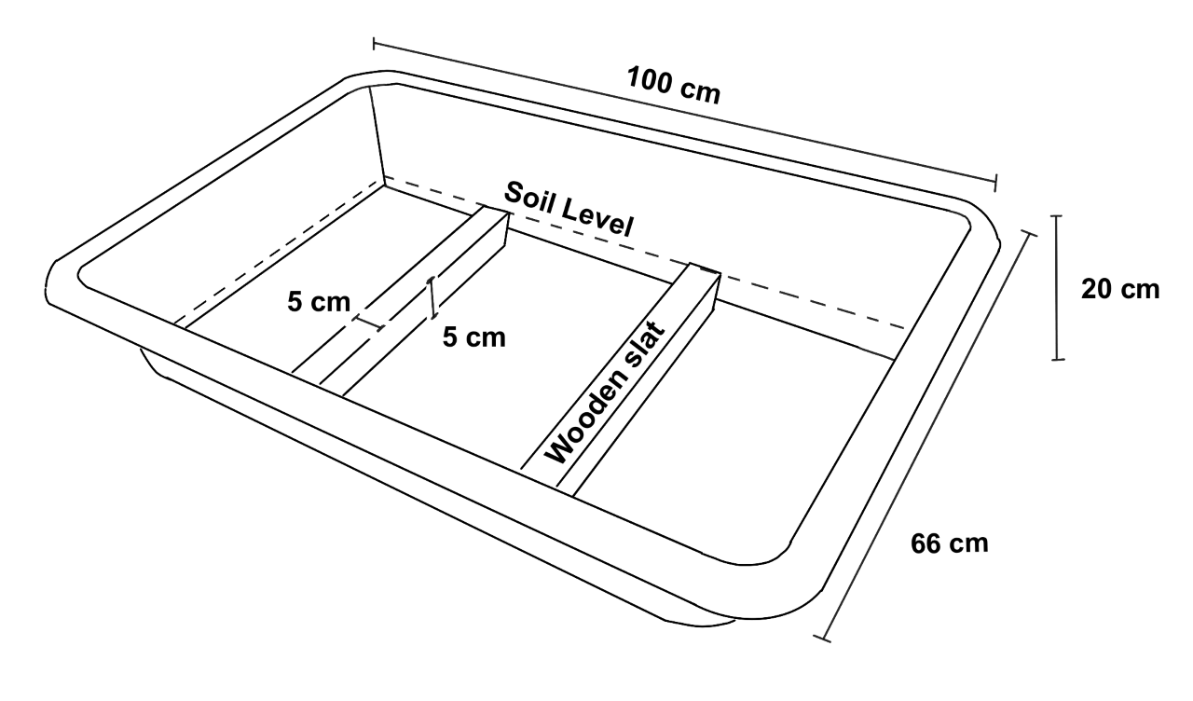
Effect of Atmospheric Relative Humidity
Soil moisture and relative humidity.
The Biosphere 2, humidity controlled environments.
Reproducible test surface.

Slide 7
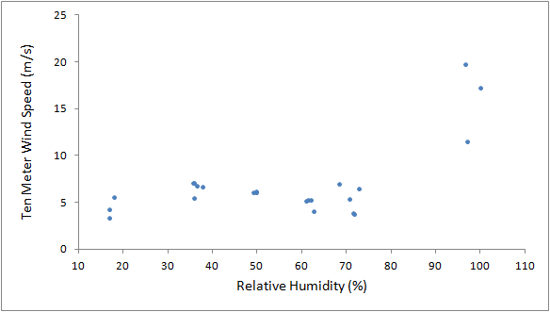
Effect of Atmospheric Relative Humidity

Slide 8
Erodible Potential of Surfaces
The potential for a dust storm can depend on presence of aerosolizable particles.
Recent wind activity.
Crusting/disturbance of the surface.
On Crusted surfaces
After the initial run, Threshold Friction Velocity values increased past the detection limit of our instrument.
On Disturbed surfaces
Threshold Friction Velocity values remained constant through successive runs.

Slide 9


